Slide 1
Hospital Performance and Patient Analytics
Data Analytics Project
Presented by: Mahendra Kumar V

Slide 2
Problem Statement :
The hospital faced multiple operational challenges:
• Long patient waiting times
• High treatment costs
• High readmission rates
• No doctor performance metrics
• Manual reporting system

Slide 3
Project objective:
Improve operational efficiency
Enhance patient care
Track and analyze revenue
Evaluate doctor performance using data

Slide 4
Dataset overview :
• Raw dataset: Hospitaldata.csv
• Cleaned dataset: Final_Cleaned_Hospital_Data.csv
• Data cleaning done using Pandas

Slide 5
DATA CLEANING
Before analysis, data was cleaned using Python(Pandas library) to ensure accuracy, consistency, and usability.

Slide 6


DATA CLEANING : Missing Values
• Identified missing values (NULL, NA, blanks) • Handled them using appropriate techniques

Slide 7

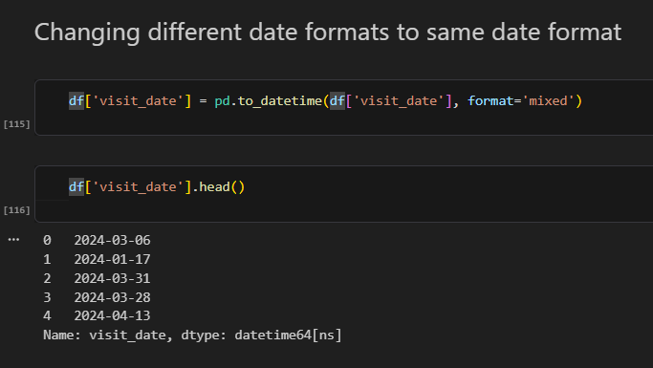
DATA CLEANING : Data Types
• Converted columns into correct data types • Ensured numerical and date fields were usable

Slide 8
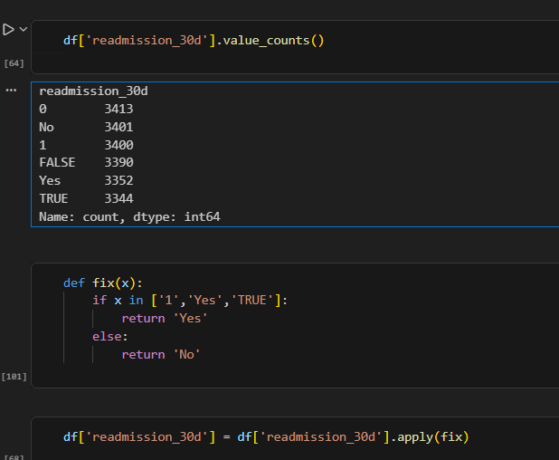


DATA CLEANING : Standardization
Before cleaning:
After cleaning:
• Standardized categorical values (Yes/No, text formats) • Fixed inconsistent departments

Slide 9
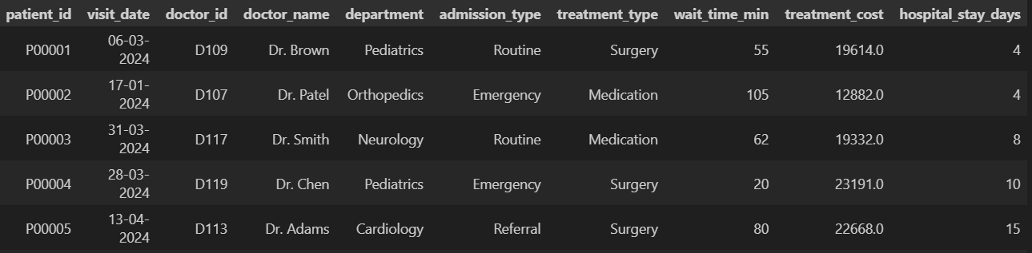
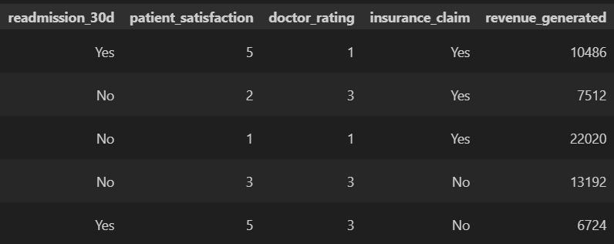
DATA CLEANING : Final Output
• Generated a clean and structured dataset • Ready for SQL and Power BI

Slide 10
SQL Processing
• Imported cleaned data into SQL • Modified incorrect data types • Performed validation and analysis

Slide 11
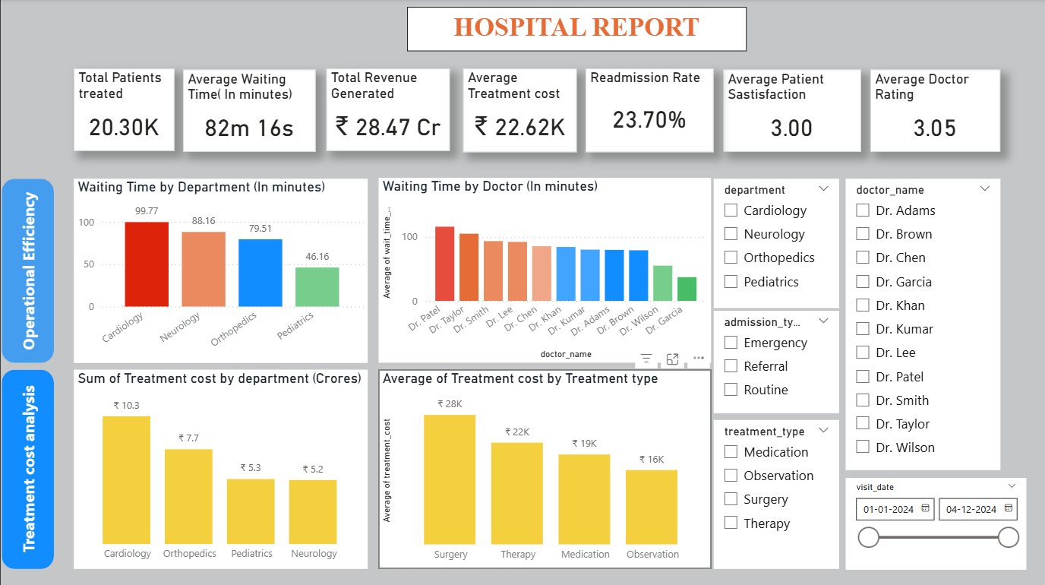
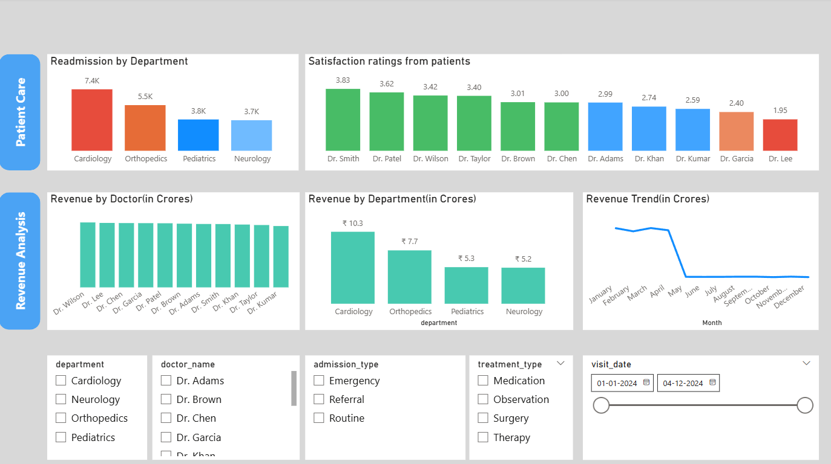
Dashboard Overview
Built an interactive Power BI dashboard to analyze:
Waiting time
Treatment cost
Readmission rate
Doctor performance
Revenue trends

Slide 12
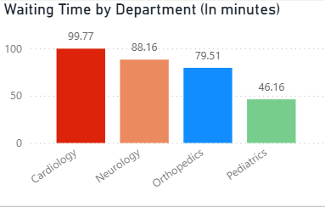
Waiting Time Analysis
• Cardiology has highest waiting time • Pediatrics has lowest • Indicates resource imbalance

Slide 13
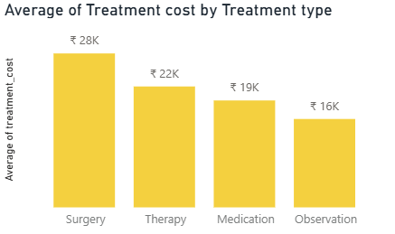
Cost Analysis
• Surgical treatments consistently show the highest average cost, indicating resource-intensive procedures • Observation-based treatments have significantly lower costs, making them the most economical option • This suggests that cost optimization efforts should focus on high-frequency surgical procedures

Slide 14
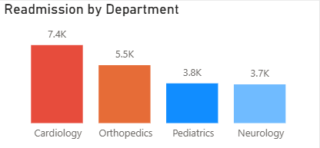
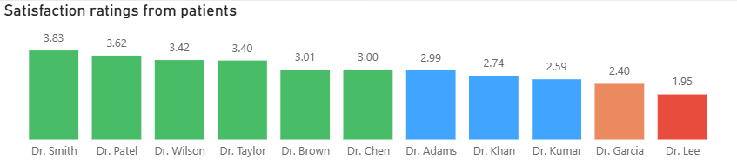
Patient Care Analysis
• Cardiology and Orthopedics shows the highest readmission rate, indicating possible challenges in handling complex cases • Other departments show relatively lower readmission rates, suggesting better recovery outcomes
Patient satisfaction differs across doctors

Slide 15
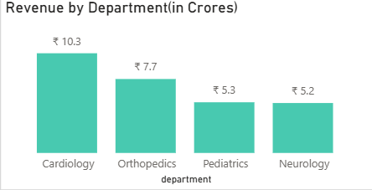
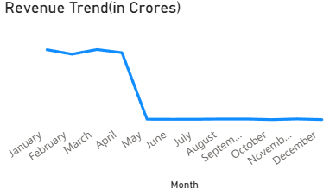
Revenue Analysis
• Cardiology contributes the highest share of hospital revenue, driven by high-cost treatments and patient volume • Revenue is concentrated among a few departments, indicating dependency on specific specialties • Revenue trends over time show stable growth, helping in financial planning and resource allocation

Slide 16
Key Insights
• Cardiology experiences the longest waiting times, indicating potential resource constraints • Surgical treatments are the primary cost drivers in the hospital • Cardiology has higher readmission rates, suggesting areas for improvement in patient care • Doctors such as Dr. Smith and Dr. Patel perform better in terms of patient satisfaction, while others may require improvement

Slide 17
Conclusion
• Identified operational inefficiencies • Improved data visibility • Enabled data-driven decisions • Provided actionable insights

Slide 18
Future Scope
• Predict readmission using ML • Automate reporting system • Real-time dashboard integration

Slide 19
THANK YOU

